Slide 1
Digital Portfolio
STUDENT NAME: SOWMYA.S
REGISTER NO AND NMID: 212402095/asunm293212402095
DEPARTMENT: BCA- COMPUTER APPLICATION
COLLEGE NAME: VIDHYA SAGAR WOMEN’S COLLEGE

Slide 2
MY PORTFOLIO
BY,
SOWMYA.S

Slide 3
PROJECT TITLE: MY PORTFOLIO

Slide 4


AGENDA
Problem Statement
Project Overview
End Users
Tools and Technologies
Portfolio design and Layout
Features and Functionality
Results and Screenshots
Conclusion
Github Link
3/21/2024 Annual Review

Slide 5

PROBLEM STATEMENT
1. Provide a personal online portfolio to showcase academic background and projects.
2. Enable smooth navigation between sections (About, Education, Skills, Projects, Contact).
3. Present skills and projects in an engaging, visually appealing way.
4. Implement an eye-catching header with animated typing effect to grab visitor attention.
5. Ensure readability across devices using responsive design elements like sections and card-like layout.
6. Facilitate seamless user experience with smooth scrolling and intuitive navigation.

Slide 6

PROJECT OVERVIEW
1. A single-page responsive Portfolio Website created using HTML, CSS, and JavaScript.
2. Features a dynamic header with a typing animation (“Hi, I'm SOWMYA SANKARANARAYANAN”).
3. Contains five main sections: About Me, Education, Skills, Projects, and Contact.
4. Navigation links that smoothly scroll to each section when clicked.
5. Clean, modern styling with a gradient header, soft background, rounded section containers, and hover effects.
6. Skills section uses stylized tags that expand on hover.
7. Smooth user interaction with scrolling feedback logged to the console.

Slide 7

END USERS?
1. Potential employers or academic evaluators reviewing your profile and skills.
2. Recruiters or internship coordinators looking for coding talent and project background.
3. Peers or mentors, to view your learning journey and coding interests.
4. Tech communities, such as GitHub or developer forums, promoting collaboration.
5. You, for self-assessment, confidence-building, and presentation purposes.

Slide 8

TOOLS AND TECHNIQUES
1. HTML5 – structured markup for sections, navigation, and accessibility.
2. CSS (with Poppins font) – for styling: gradients, shadows, responsive containers, hover effects, border-radius.
3. Typing animation via CSS @keyframes (typing and blink) to animate header text.
4. JavaScript for smooth scrolling on navigation link click (scrollIntoView).
5. Event listeners to add interactive behaviors (click, scroll).
6. Responsive layout – centered sections, max-width constraints, margins, padding, suitable for various screen sizes.
7. Console logging active section IDs on scroll for debugging/development feedback.
8. Code structure – clean separation of HTML, CSS, and JS, with comments and modular design.

Slide 9
POTFOLIO DESIGN AND LAYOUT
1. Gradient header (purple → blue) draws attention and creates visual contrast.
2. Typography: clean, modern font (“Poppins”) and hierarchical heading structure.
3. Section cards: white background, rounded corners, soft shadows for a “card” effect.
4. Navigation bar: simple links whose hover color changes to gold (#ffd700) — intuitive cues.
5. Hover effects: skill tags scale up and change color for interactivity.
6. Consistent spacing: generous padding and margins ensure readability and balance.
7. Footer: dark background with copyright notice, grounding the page.

Slide 10
FEATURES AND FUNCTIONALITY
1. Smooth section navigation – clicking nav links brings you to the target section smoothly.
2. Typing header animation that types out the greeting and blinks for dynamic effect.
3. Skills hover effect for visual feedback and engagement.
4. Section highlighting in console when scrolling — useful for debugging or future adding active state UI.
5. Responsive layout that adapts to different screen sizes (max-widths, flexible containers).
6. Contact links: mailto (email) and tel (phone) clickable links for direct communication.

Slide 11
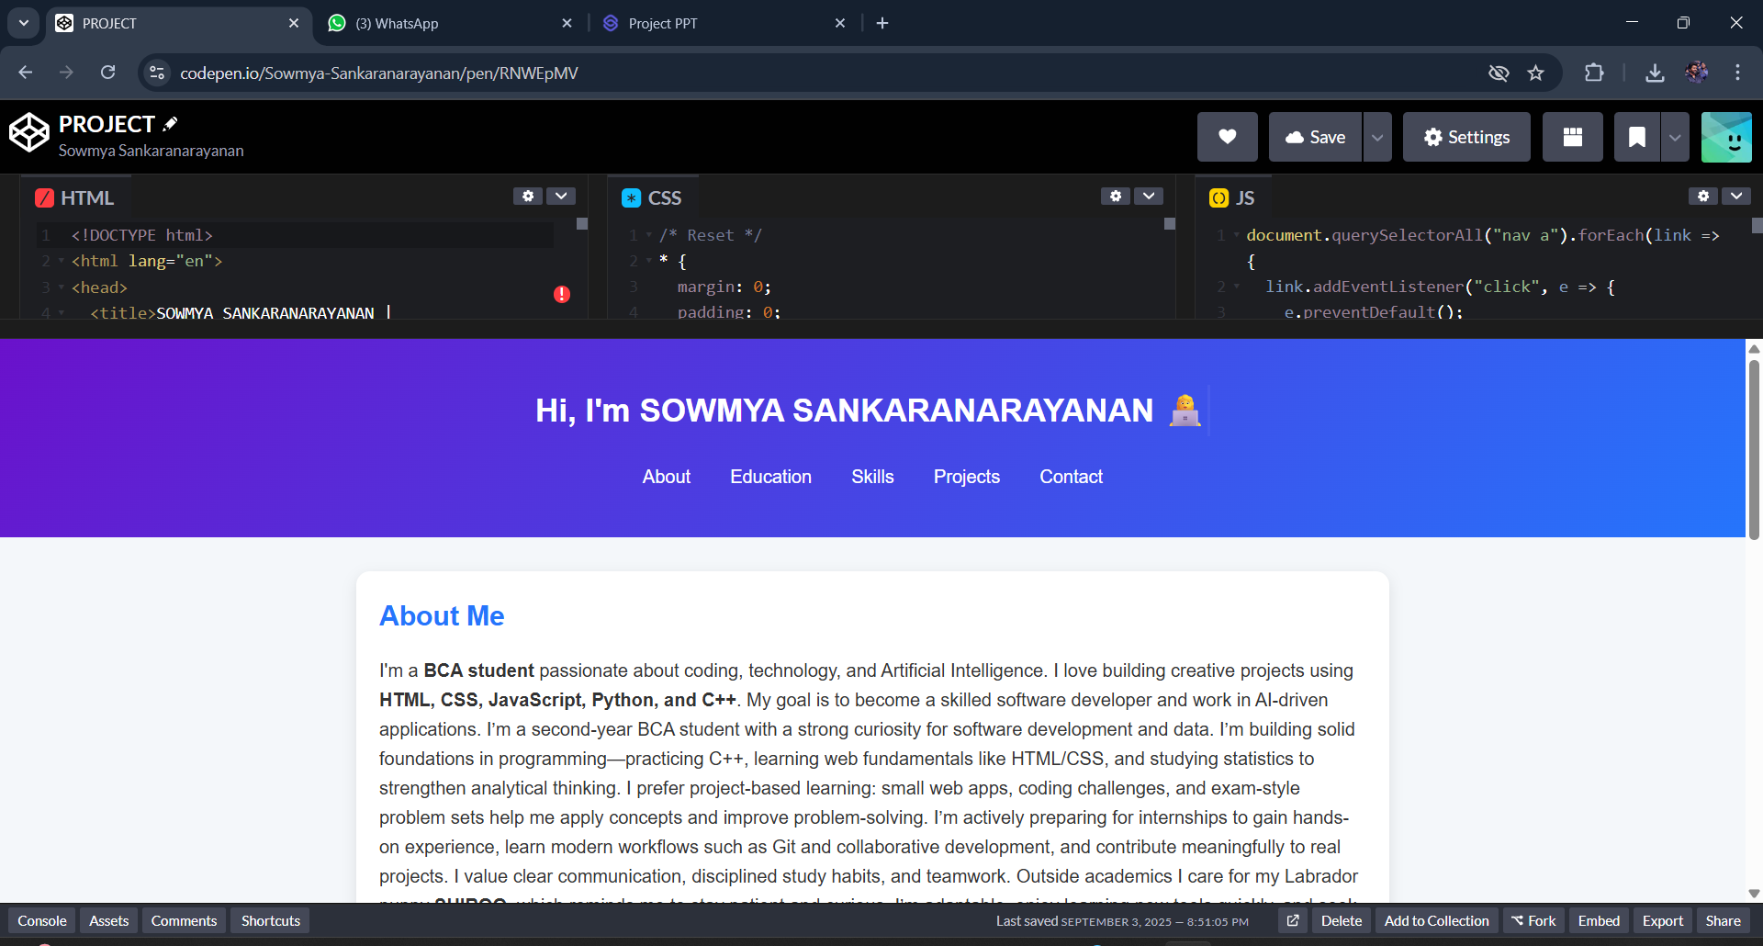

RESULTS AND SCREENSHOTS
3/21/2024 Annual Review

Slide 12
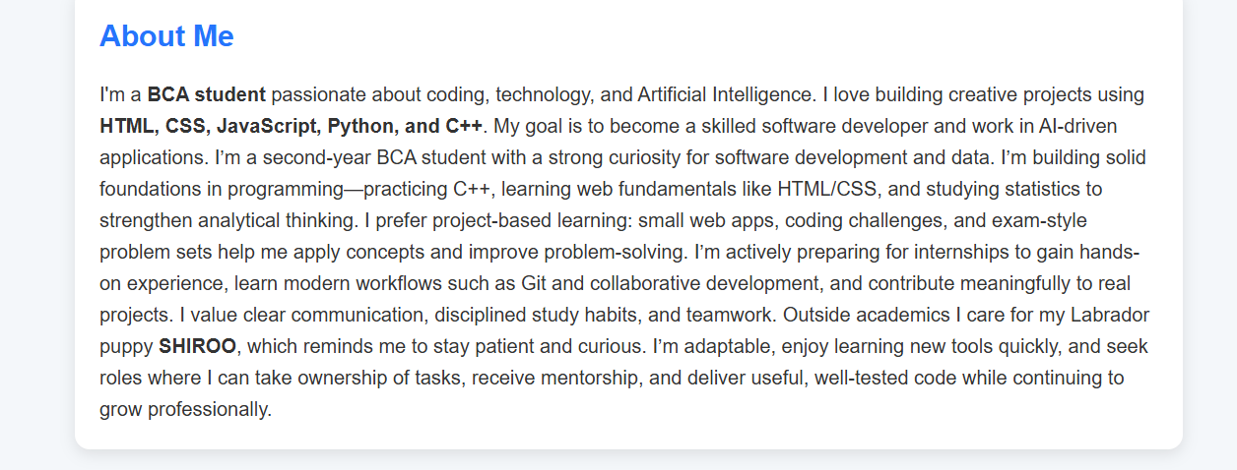
RESULT AND SCREENSHOT

Slide 13
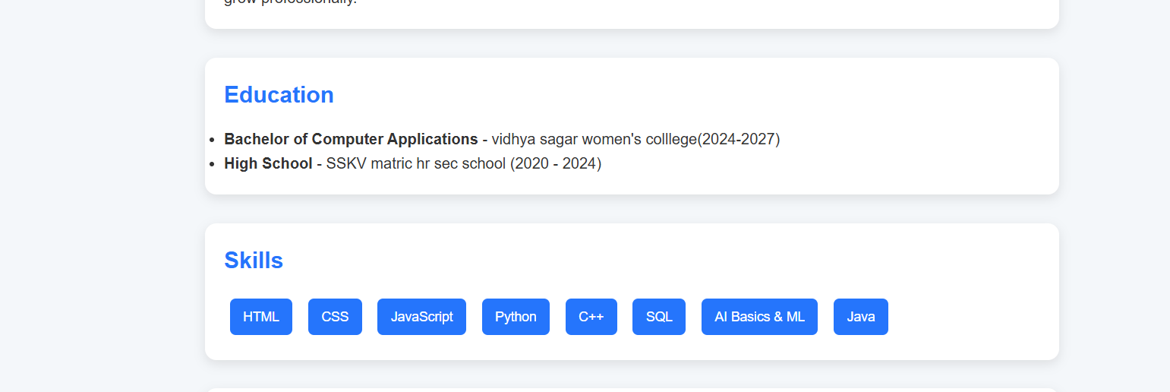
RESULT AND SCREENSHOT

Slide 14
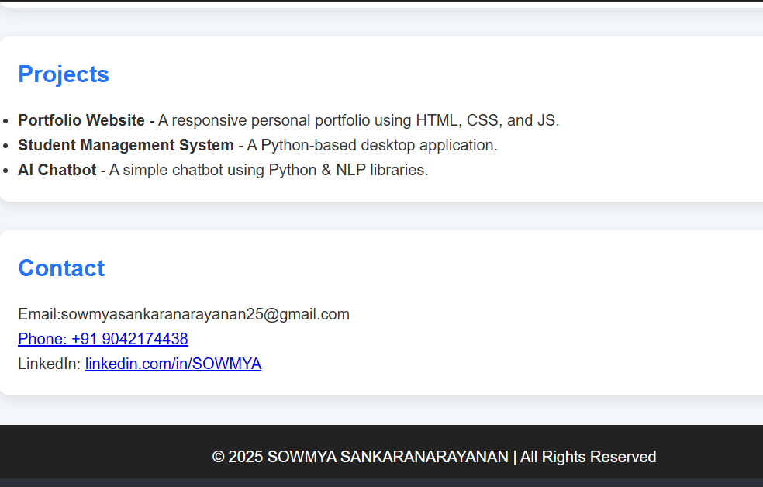
RESULT AND SCREENSHOT

Slide 15
CONCLUSION
This portfolio site is a sleek, responsive single-page showcase built with clean HTML, stylish CSS, and interactive JavaScript. It cleverly combines visual appeal—through gradient headers, card-style section layouts, and smooth animations—with practical navigation and accessibility. Each section—About, Education, Skills, Projects, and Contact—presents relevant information in a structured way, and the typing animation adds a polished personal touch. The site supports smooth scrolling to enhance user experience, while hover effects and console logging underline a thoughtful development process. Overall, the project effectively communicates your academic background, technical competencies, and creative drive in a modern, user-friendly format, making it an excellent foundation for future enhancements.

